Slide 1
Multimedia and Text Indexing

Slide 2
Midterm
Monday, March 19, 2018 in class
Closed Books and notes
One cheat sheet: 8.5" by 11" sheet of notes (both sides)
Topics
  Spatial
  Temporal
  Spatio-temporal
  Time Series
  All papers and lecture notes on these topics

Slide 3

Multimedia Data Management
The need to query and analyze vast amounts of multimedia data (i.e., images, sound tracks, video tracks) has increased in the recent years.
Joint Research from Database Management, Computer Vision, Signal Processing and Pattern Recognition aims to solve problems related to multimedia data management.

Slide 4


Multimedia Data
There are four major types of multimedia data: images, video sequences, sound tracks, and text.
From the above, the easiest type to manage is text, since we can order, index, and search text using string management techniques, etc.
Management of simple sounds is also possible by representing audio as signal sequences over different channels.
Image retrieval has received a lot of attention in the last decade (CV and DBs). The main techniques can be extended and applied also for video retrieval.

Slide 5
Content-based Image Retrieval
Images were traditionally managed by first annotating their contents and then using text-retrieval techniques to index them.
However, with the increase of information in digital image format some drawbacks of this technique were revealed:
  Manual annotation requires vast amount of labor
  Different people may perceive differently the contents of an image; thus no objective keywords for search are defined
A new research field was born in the 90’s: Content-based Image Retrieval aims at indexing and retrieving images based on their visual contents.

Slide 6
Feature Extraction
The basis of Content-based Image Retrieval is to extract and index some visual features of the images.
There are general features (e.g., color, texture, shape, etc.) and domain-specific features (e.g., objects contained in the image).
  Domain-specific feature extraction can vary with the application domain and is based on pattern recognition
  On the other hand, general features can be used independently from the image domain.

Slide 7
Color Features
To represent the color of an image compactly, a color histogram is used. Colors are partitioned to k groups according to their similarity and the percentage of each group in the image is measured.
Images are transformed to k-dimensional points and a distance metric (e.g., Euclidean distance) is used to measure the similarity between them.
k-dimensional space
k-bins

Slide 8
Using Transformations to Reduce Dimensionality
In many cases the embedded dimensionality of a search problem is much lower than the actual dimensionality
Some methods apply transformations on the data and approximate them with low-dimensional vectors
The aim is to reduce dimensionality and at the same time maintain the data characteristics
If d(a,b) is the distance between two objects a, b in real (high-dimensional) and d’(a’,b’) is their distance in the transformed low-dimensional space, we want d’(a’,b’)≤d(a,b).
d’(a’,b’)
d(a,b)

Slide 9
Multimedia Indexing
  Every indexing model must follow a retrieval semantics. The multimedia indexing model must support the similarity queries.
  Two types similarity queries:
  range queries
  return documents similar more than a given threshold
  k nearest neighbour queries
  return the first k most similar documents
Notes:
ADBIS 2003

Slide 10
Metric Indexing
Feature vectors are indexed according to distances between each other.
As a dissimilarity measure, a distance function d(O_{i},O_{j}) is specified such that the metric axioms are satisfied:
d(O_{i},O_{i}) = 0 reflexivity
d(O_{i},O_{j}) > 0 positivity
d(O_{i},O_{j}) = d(O_{j},O_{i}) symmetry
d(O_{i},O_{k}) + d(O_{k},O_{j}) ≥ d(O_{i},O_{j}) triangular inequality
Metric structures:
Main memory structures: cover-tree, vp-tree, mvp-tree
Disk-based structures: M-tree, Slim-tree
Notes:
ADBIS 2003

Slide 11
The M-tree
Inherently dynamic structure
Disk-oriented (fixed-size nodes)
Built in a bottom-up fashion
  Inspired by R-trees and B-trees
All data in leaf nodes
Internal nodes: pointers to subtrees and additional information
P. Zezula, G. Amato, V. Dohnal, M. Batko: Similarity Search: The Metric Space Approach
http://www.nmis.isti.cnr.it/amato/similarity-search-book/slides/

Slide 12



M-tree: Internal Node
Internal node consists of an entry for each subtree
Each entry consists of:
  Pivot: p
  Covering radius of the sub-tree: r^{c}
  Distance from p to parent pivot p^{p}: d(p,p^{p})
  Pointer to sub-tree: ptr
  All objects in subtree ptr are within the distance r^{c} from p.

Slide 13



M-tree: Leaf Node
leaf node contains data entries
each entry consists of pairs:
  object (its identifier): o
  distance between o and its parent pivot: d(o,o^{p})

Slide 14
M-tree: Example
o₅
o₁₀
o₁₁
o₂
o₃
o₇
o₈
o₁
Covering radius
o₆
o₄
o₉
Distance to parent
o₁
4.5
-.-
o₂
6.9
-.-
o₁
1.4
0.0
o₁₀
1.2
3.3
o₇
1.3
3.8
o₂
2.9
0.0
o₄
1.6
5.3
o₁
0.0
o₆
1.4
o₁₀
0.0
o₃
1.2
o₂
0.0
o₈
2.9
o₇
0.0
o₅
1.3
o₁₁
1.0
o₄
0.0
o₉
1.6
Distance to parent

Slide 15
M-tree: Insert
Insert a new object o_{N}:
recursively descend the tree to locate the most suitable leaf for o_{N}
in each step enter the subtree with pivot p for which:
  no enlargement of radius r^{c} needed, i.e., d(o_{N},p) ≤ r^{c}
    in case of ties, choose one with p nearest to o_{N}
  minimize the enlargement of r^{c}

Slide 16
M-tree: Insert (cont.)
when reaching leaf node N then:
  if N is not full then store o_{N} in N
  else Split(N,o_{N}).

Slide 17
M-tree: Split
Split(N,o_{N}):
Let S be the set containing all entries of N and o_{N}
Select pivots p₁ and p₂ from S
Partition S to S₁ and S₂ according to p₁ and p₂
Store S₁ in N and S₂ in a new allocated node N’
If N is root
  Allocate a new root and store entries for p₁, p₂ there
else (let N^{p} and p^{p} be the parent node and parent pivot of N)
  Replace entry p^{p} with p₁
  If N^{p} is full, then Split(N^{p},p₂)
  else store p₂ in node N^{p}

Slide 18
M-tree: Pivot Selection
Several pivots selection policies
  RANDOM – select pivots p₁, p₂ randomly
  m_RAD – select p₁, p₂ with minimum (r₁^{c} + r₂^{c})
  mM_RAD – select p₁, p₂ with minimum max(r₁^{c}, r₂^{c})
  M_LB_DIST – let p₁ = p^{p} and p₂ = o_{i} | max_{i} { d(o_{i},p^{p}) }
    Uses the pre-computed distances only
Two versions (for most of the policies):
  Confirmed – reuse the original pivot p^{p} and select only one
  Unconfirmed – select two pivots (notation: RANDOM_2)
In the following, the mM_RAD_2 policy is used.

Slide 19
M-tree: Split Policy
Partition S to S₁ and S₂ according to p₁ and p₂
Unbalanced
  Generalized hyperplane
Balanced
  Larger covering radii
p₂
p₂
p₁
p₁

Slide 20
M-tree: Range Search
Given R(q,r):
Traverse the tree in a depth-first manner
In an internal node, for each entry ⟨p,r^{c},d(p,p^{p}),ptr⟩
  Prune the subtree if |d(q,p^{p}) – d(p,p^{p})| – r^{c} > r
  Application of the pivot-pivot constraint
r
p^{p}
q
p^{p}
p
r^{c}
p
r
r^{c}
q

Slide 21
M-tree: Range Search (cont.)
If not discarded, compute d(q,p) and
  Prune the subtree if d(q,p) – r^{c} > r
  Application of the range-pivot constraint
All non-pruned entries are searched recursively.
r^{c}
r
q
p

Slide 22
M-tree: Range Search in Leaf Nodes
In a leaf node, for each entry ⟨o,d(o,o^{p})⟩
  Ignore entry if |d(q,o^{p}) – d(o,o^{p})| > r
  else compute d(q,o) and check d(q,o) ≤ r
  Application of the object-pivot constraint

Slide 23
M-tree: k-NN Search
Given k-NN(q):
Based on a priority queue and the pruning mechanisms applied in the range search.
Priority queue:
  Stores pointers to sub-trees where qualifying objects can be found.
  Considering an entry E=⟨p,r^{c},d(p,p^{p}),ptr⟩, the pair ⟨ptr,d_{min}(E)⟩ is stored.
  d_{min}(E)=max { d(p,q) – r^{c}, 0 }
Range pruning: instead of fixed radius r, use the distance to the k-th current nearest neighbor.

Slide 24
Text Retrieval (Information retrieval)
Given a database of documents, find documents containing “data”, “retrieval”
Applications:
  Web
  law + patent offices
  digital libraries
  information filtering

Slide 25
Problem - Motivation
Types of queries:
  boolean (‘data’ AND ‘retrieval’ AND NOT ...)
  additional features (‘data’ ADJACENT ‘retrieval’)
  keyword queries (‘data’, ‘retrieval’)
How to search a large collection of documents?

Slide 26
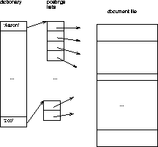
Text – Inverted Files

Slide 27
Text – Inverted Files
Q: space overhead?
A: mainly, the postings lists

Slide 28
Text – Inverted Files
how to organize dictionary?
stemming – Y/N?
  Keep only the root of each word ex. inverted, inversion → invert
insertions?

Slide 29
Text – Inverted Files
how to organize dictionary?
  B-tree, hashing, TRIEs, PATRICIA trees, ...
stemming – Y/N?
insertions?

Slide 30
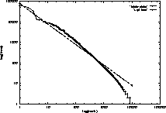
Text – Inverted Files
postings list – more Zipf distr.: eg., rank-frequency plot of ‘Bible’
log(freq)
freq ~ 1/rank / ln(1.78V)
log(rank)

Slide 31
Text – Inverted Files
postings lists
  Cutting+Pedersen
    (keep first 4 in B-tree leaves)
  how to allocate space: [Faloutsos+92]
    geometric progression
  compression (Elias codes) [Zobel+] – down to 2% overhead!
  Conclusions: needs space overhead (2%-300%), but it is the fastest

Slide 32
Text - Detailed outline
Text databases
  problem
  inversion
  signature files (a.k.a. Bloom Filters)
  Vector model and clustering
  information filtering and LSI

Slide 33
Vector Space Model and Clustering
Keyword (free-text) queries (vs Boolean)
each document: -> vector (HOW?)
each query: -> vector
search for ‘similar’ vectors

Slide 34
Vector Space Model and Clustering
main idea: each document is a vector of size d: d is the number of different terms in the database
document
aaron
data
zoo
‘indexing’
...data...
d (= vocabulary size)

Slide 35
Document Vectors
Documents are represented as “bags of words”
OR as vectors.
  A vector is like an array of floating points
  Has direction and magnitude
  Each vector holds a place for every term in the collection
  Therefore, most vectors are sparse

Slide 36
Document Vectors
One location for each word.
A
B
C
D
E
F
G
H
I
nova galaxy heat h’wood film role diet fur
10 5 3
5 10
10 8 7
9 10 5
10 10
9 10
5 7 9
6 10 2 8
7 5 1 3
“Nova” occurs 10 times in text A
“Galaxy” occurs 5 times in text A
“Heat” occurs 3 times in text A
(Blank means 0 occurrences.)

Slide 37
Document Vectors
One location for each word.
A
B
C
D
E
F
G
H
I
nova galaxy heat h’wood film role diet fur
10 5 3
5 10
10 8 7
9 10 5
10 10
9 10
5 7 9
6 10 2 8
7 5 1 3
“Hollywood” occurs 7 times in text I
“Film” occurs 5 times in text I
“Diet” occurs 1 time in text I
“Fur” occurs 3 times in text I

Slide 38
Document Vectors
Document ids
A
B
C
D
E
F
G
H
I
nova galaxy heat h’wood film role diet fur
10 5 3
5 10
10 8 7
9 10 5
10 10
9 10
5 7 9
6 10 2 8
7 5 1 3

Slide 39
We Can Plot the Vectors
Star
Doc about movie stars
Doc about astronomy
Doc about mammal behavior
Diet

Slide 40
Assigning Weights to Terms
Binary Weights
Raw term frequency
tf x idf
  Recall the Zipf distribution
  Want to weight terms highly if they are
    frequent in relevant documents … BUT
    infrequent in the collection as a whole

Slide 41
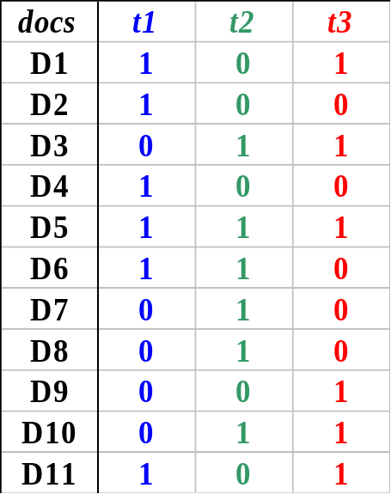
Binary Weights
Only the presence (1) or absence (0) of a term is included in the vector

Slide 42
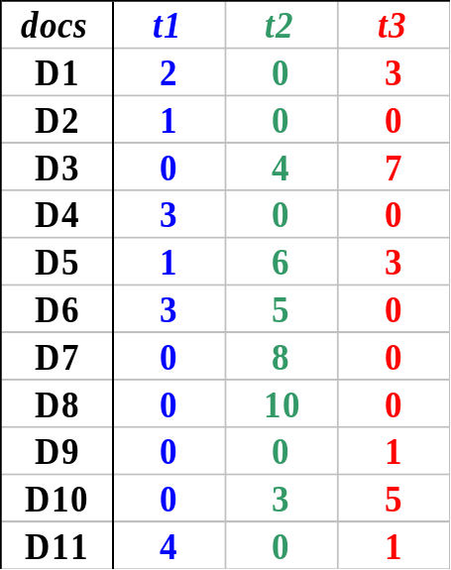
Raw Term Weights
The frequency of occurrence for the term in each document is included in the vector

Slide 43
Assigning Weights
tf x idf measure:
  term frequency (tf)
  inverse document frequency (idf) -- a way to deal with the problems of the Zipf distribution
Goal: assign a tf * idf weight to each term in each document

Slide 44
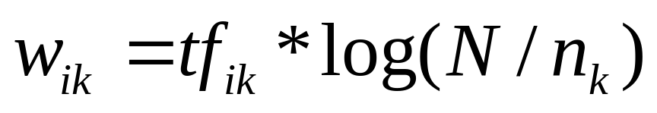
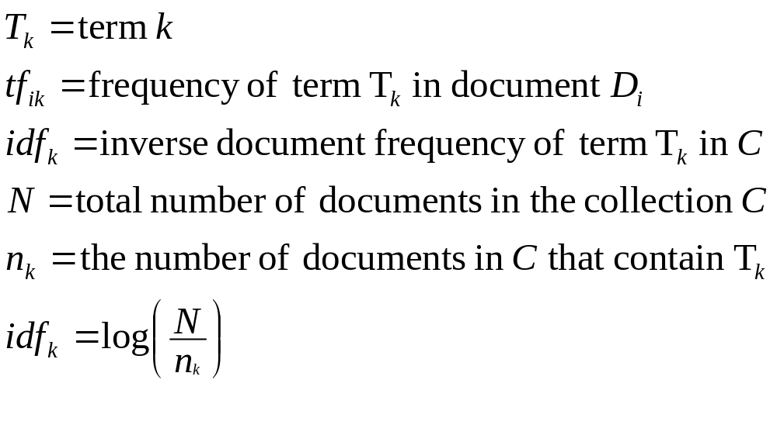
tf x idf

Slide 45
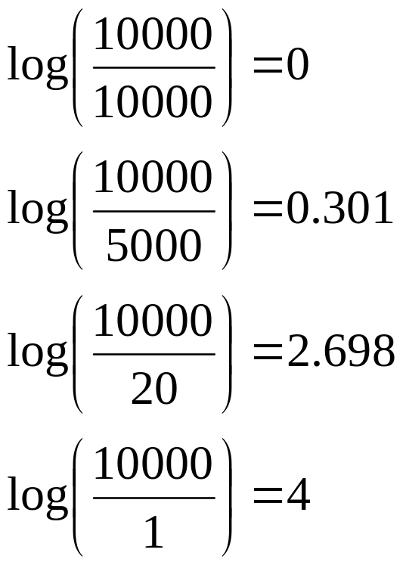
Inverse Document Frequency
IDF provides high values for rare words and low values for common words
For a collection
of 10000 documents

Slide 46
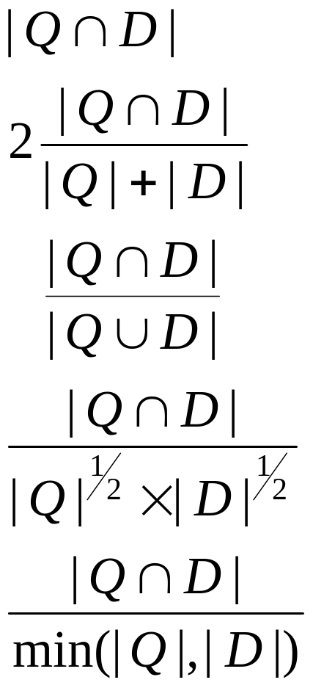
Similarity Measures for document vectors (seen as sets)
Simple matching (coordination level match)
Dice’s Coefficient
Jaccard’s Coefficient
Cosine Coefficient
Overlap Coefficient

Slide 47
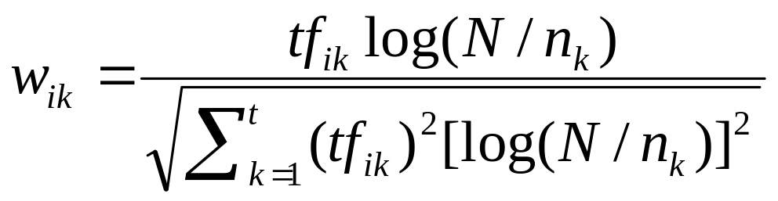
tf x idf normalization
Normalize the term weights (so longer documents are not unfairly given more weight)
  normalize usually means force all values to fall within a certain range, usually between 0 and 1, inclusive.

Slide 48
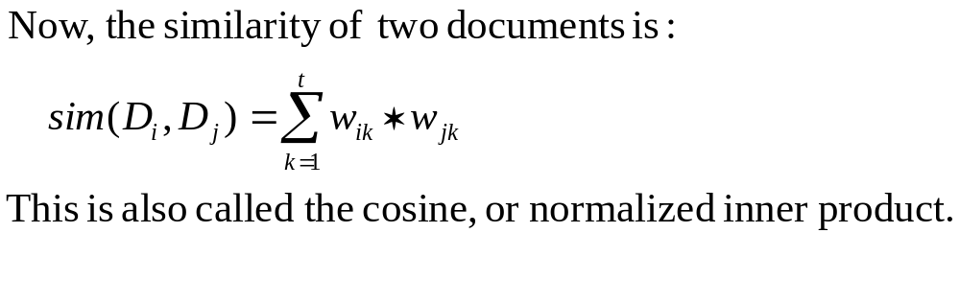
Vector space similarity
(use the weights to compare the documents)

Slide 49
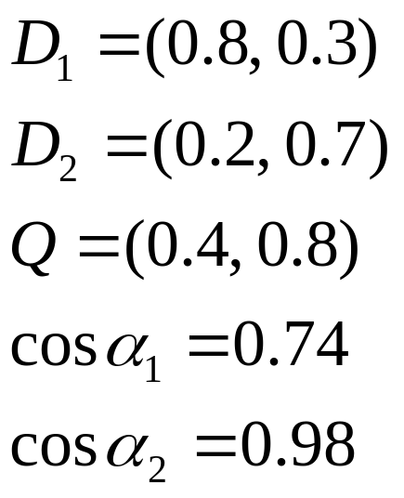





Computing Similarity Scores
1.0
0.8
0.6
0.4
0.2
0.2
0.4
0.6
0.8
1.0

Slide 50
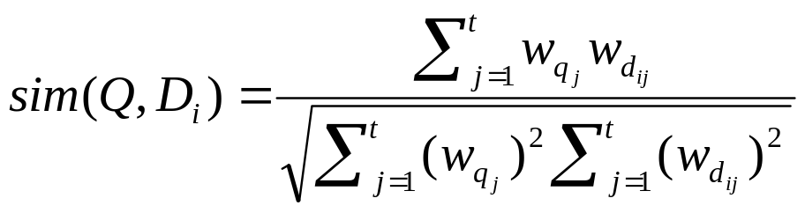

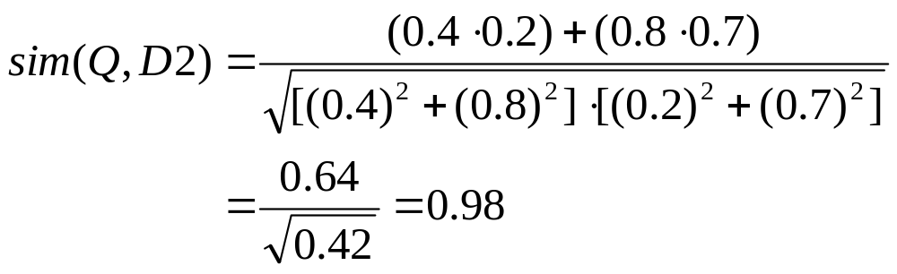

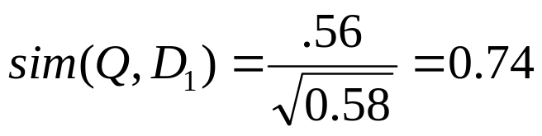
Vector Space with Term Weights and Cosine Matching
D_{i}=(d_{i1},w_{di1};d_{i2}, w_{di2};…;d_{it}, w_{dit})
Q =(q_{i1},w_{qi1};q_{i2}, w_{qi2};…;q_{it}, w_{qit})
Term B
1.0
Q = (0.4,0.8)
D1=(0.8,0.3)
D2=(0.2,0.7)
D₂
Q
0.8
0.6
0.4
D₁
0.2
0
0.2
0.4
0.6
0.8
1.0
Term A

Slide 51
Text - Detailed outline
Text databases
  problem
  full text scanning
  inversion
  signature files (a.k.a. Bloom Filters)
  Vector model and clustering
  information filtering and LSI

Slide 52
Information Filtering + LSI
[Foltz+,’92] Goal:
  users specify interests (= keywords)
  system alerts them, on suitable news-documents
Major contribution: LSI = Latent Semantic Indexing
  latent (‘hidden’) concepts

Slide 53
Information Filtering + LSI
Main idea
map each document into some ‘concepts’
map each term into some ‘concepts’
‘Concept’:~ a set of terms, with weights, e.g.
  “data” (0.8), “system” (0.5), “retrieval” (0.6) -> DBMS_concept

Slide 54
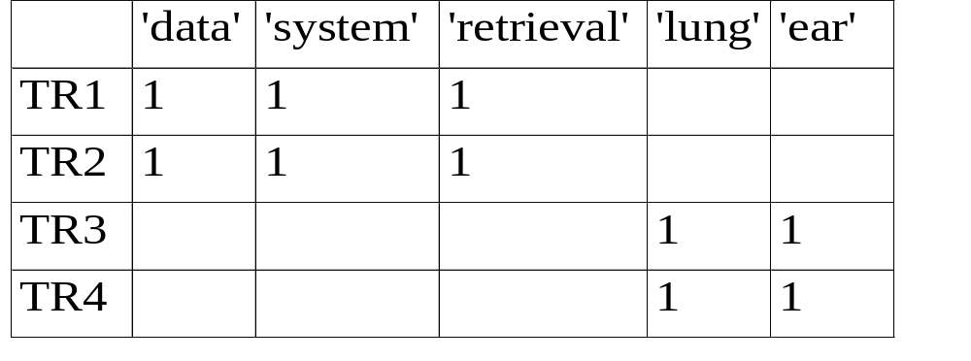
Information Filtering + LSI
Pictorially: term-document matrix (BEFORE)

Slide 55
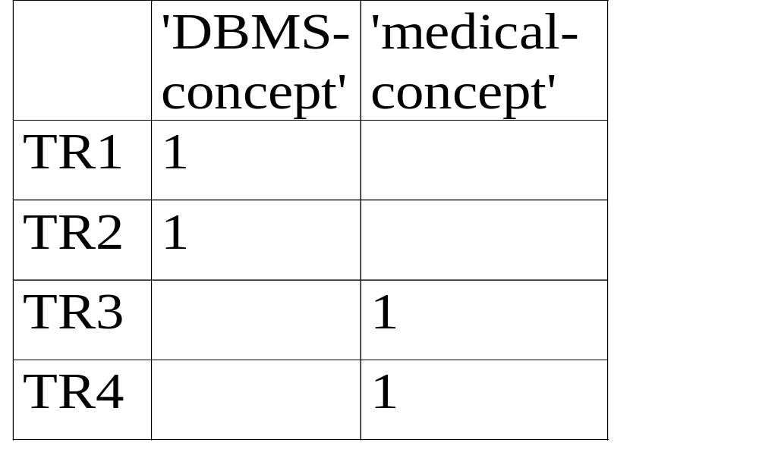
Information Filtering + LSI
Pictorially: concept-document matrix and...

Slide 56
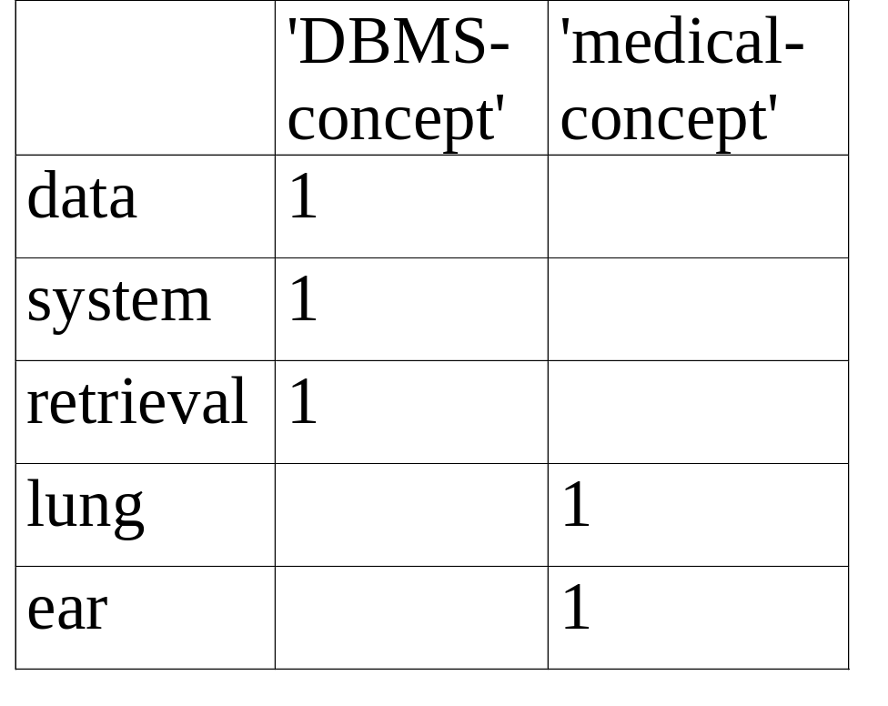
Information Filtering + LSI
... and concept-term matrix

Slide 57
Information Filtering + LSI
Q: How to search, eg., for ‘system’?

Slide 58
Information Filtering + LSI
A: find the corresponding concept(s); and the corresponding documents

Slide 59
Information Filtering + LSI
A: find the corresponding concept(s); and the corresponding documents

Slide 60
Information Filtering + LSI
Thus it works like an (automatically constructed) thesaurus:
we may retrieve documents that DON’T have the term ‘system’, but they contain almost everything else (‘data’, ‘retrieval’)

